Slide 1

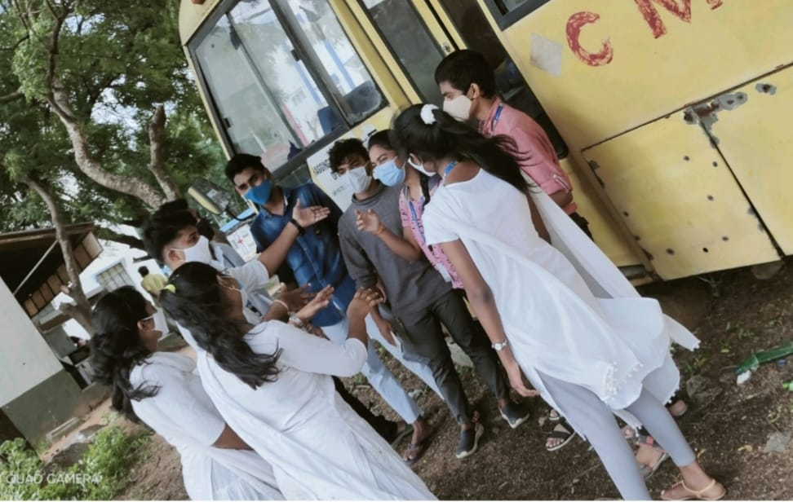
COLLEGE BUS TRACKING
TEAM CODE : NECX8201
CMR COLLEGE OF ENGINEERING & TECHNOLOGIES
( Autonomous )
Kandlakoya , medchal , HYDERABAD
YEAR-2nd
TEAM:
C.Chandra Pavaneswara Reddy- EEE
SK.Yeswanth- MECH
K.Sai Rishitha- EEE
P.Varshitha- EEE

Slide 2
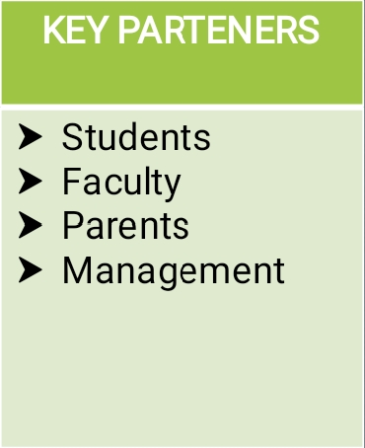
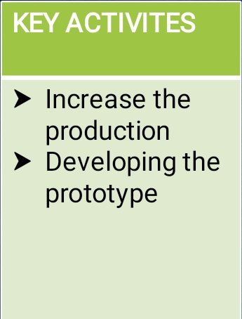
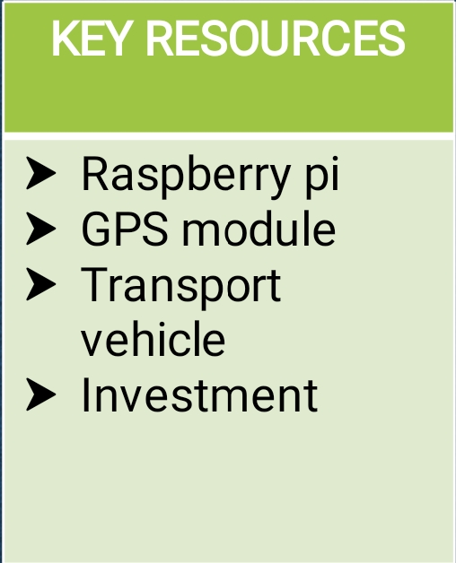
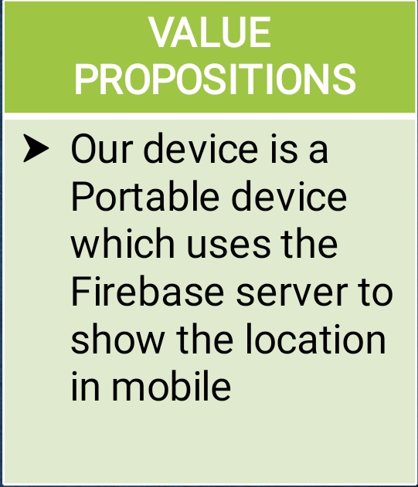
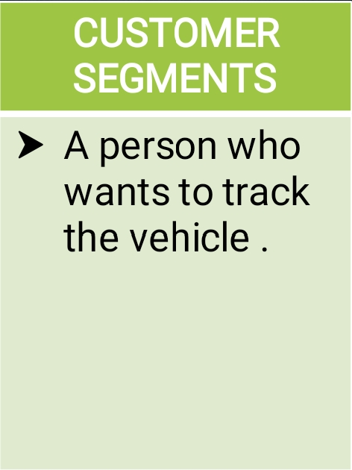
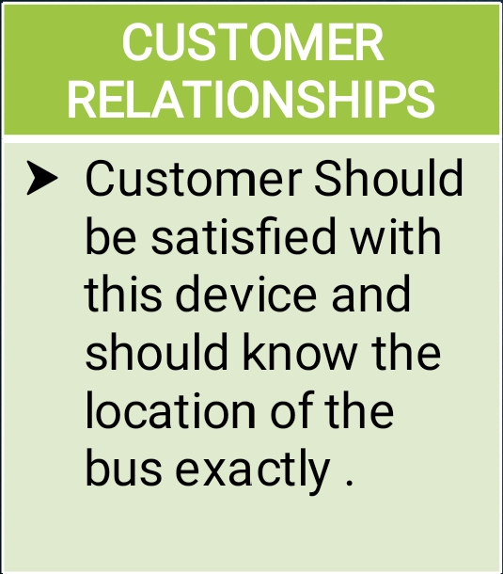
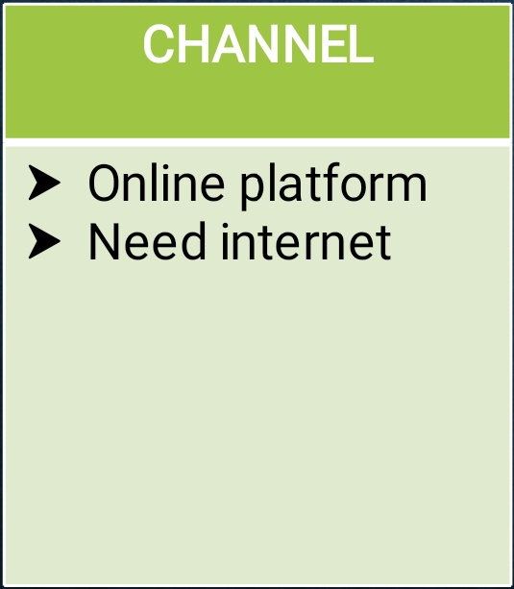
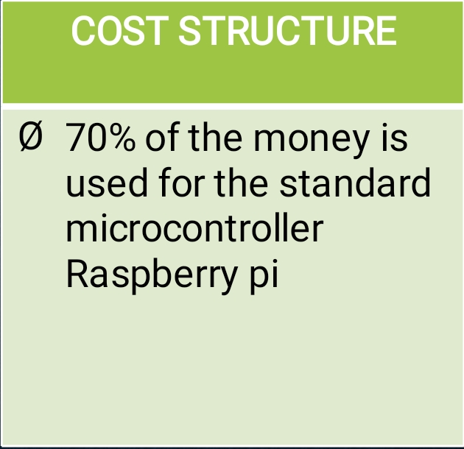
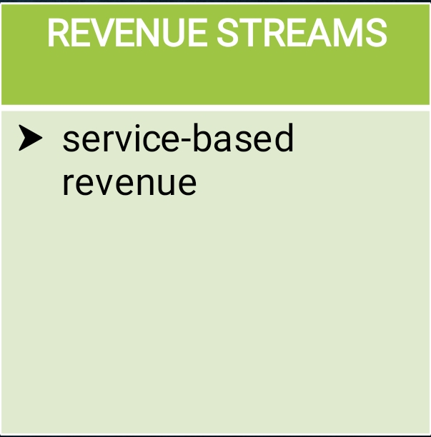
BUSINESS MODEL CANVAS

Slide 3
TABLE OF CONTENTS
Topic & Team
Problem Statement
Market analysis
Solution
How would you make money?
Roadmap
Action Plan
What do you need to make it happen?
Ask the Question
Appendix-Risks, Challenges & Opportunities

Slide 4
PROBLEM STATEMENT
Students are facing problem in boarding college bus. They exactly don’t know at which time the bus will arrive to their stops because of traffic jams and other bus related issues. So because of this students may miss the bus or they can not reach the college or school on time.
To solve this problem we have come up with ‘COLLEGE BUS TRACKING’. With this they can track the vehicle movement and know the location of the bus. Because of this the students can save their time and can reach their destination on time.

Slide 5
MARKET SIZE & COMPETITION
The problem statement we are working on, is lated to students. There are some tracking models to solve this problems but they are different from this model. The other models which are existing in the market includes more components and very complicated to make working model.
Our current competitors are the users of Google GPS tracking applications like Uber , Ola , swiggy , etc ,.
There are many applications for GPS tracking but we are uniquely using this for helping students to reach their destination on time without wasting their time.

Slide 6
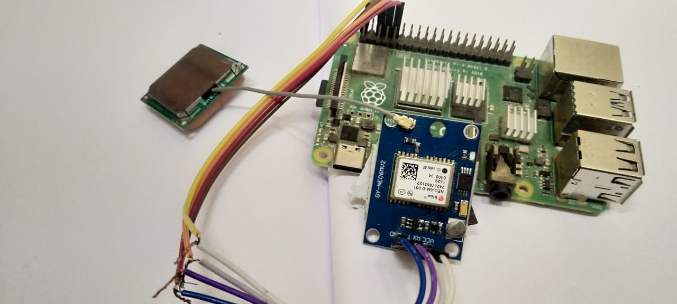
SOLUTION
We have come up with the ‘COLLEGE BUS TRACKING SYSTEM’ as a solution. It is very useful tracking system for students which includes robust microcontroller Raspberry pi, GPS module and fire base server. Students can see the bus location in the mobile app linked with this tracking system and it will definitely solve of the students who spend lot of time in waiting for the bus to come to their stop.

Slide 7
ROADMAP
IDEA
TO KNOW THE LOCATION OF COLLEGE BUS
PROTOTYPE
TO TEST THE DEVICE IN REAL TIME
ACCELERATE
TO BUILD AND TO PRESENT THE IDEA WITH COLLEGE BUSES
MVP LAUNCH

Slide 8
HOW WOULD YOU MAKE MONEY
TOTAL COST OF THE PRODUCT-5000
SERVICE COST OF THE PRODUCT-800
UNIT SELLING PRICE-6400
PROFIT PER UNIT-600

Slide 9
ACTION PLAN
Our plan for the next 90 days
To make this prototype as a business model
Pitching the idea with the colleges
Get investment to make production
To reduce the cost of this device
It is a portable and service based project
It is unique from the existing ones

Slide 10
WHAT DO YOU NEED TO MAKE IT HAPPEN
We use raspberry pi and GPS module in our project, raspberry pi is the standard technology microcontroller.
Consulting the different colleges and managements to present this idea and to make this happen in a bigger way.
Need to hire fire base server and app developers if the customers are more.
We need the external help to test the prototype and taking it to production. It would cost Rs. 5000 /-

Slide 11
QUESTIONS
Would you be interested in investing in our project and support us?
Would you help us to meet with managements to pitch our idea?

Slide 12
APPENDIX
RISKS
Economic risk
May not be suitable for network issue areas
CHALLENGES
Developing efficient application and maintaining application when more number of customers increases
Device installation
OPPORTUNITIES
We not only can use this device for college bus but also for individual vehicles

Slide 13
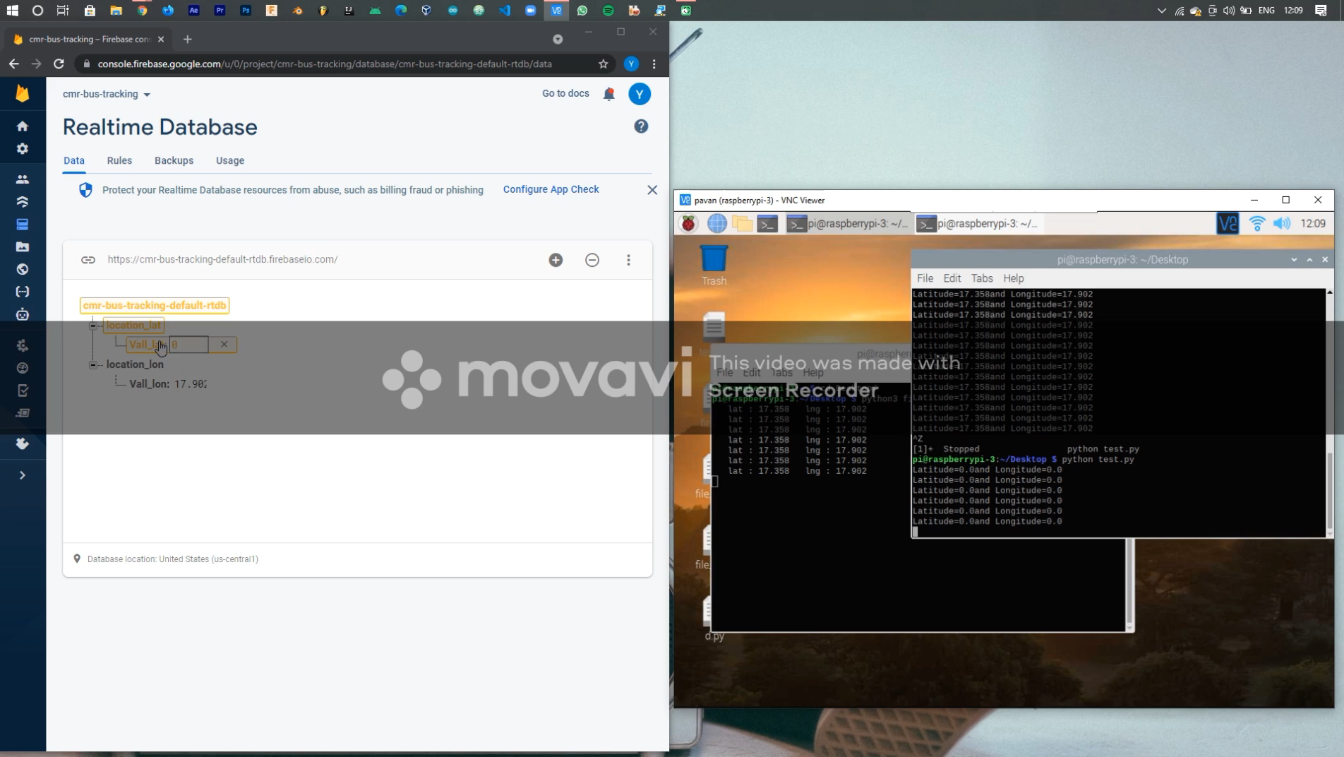
Working Model Video

Slide 14
THANK YOU

